Slide 1
Increasing Kia & Hyundai Car Thefts Across the U.S
Created By : Chitramoy Mukherjee
DSC-640 T301

Slide 2
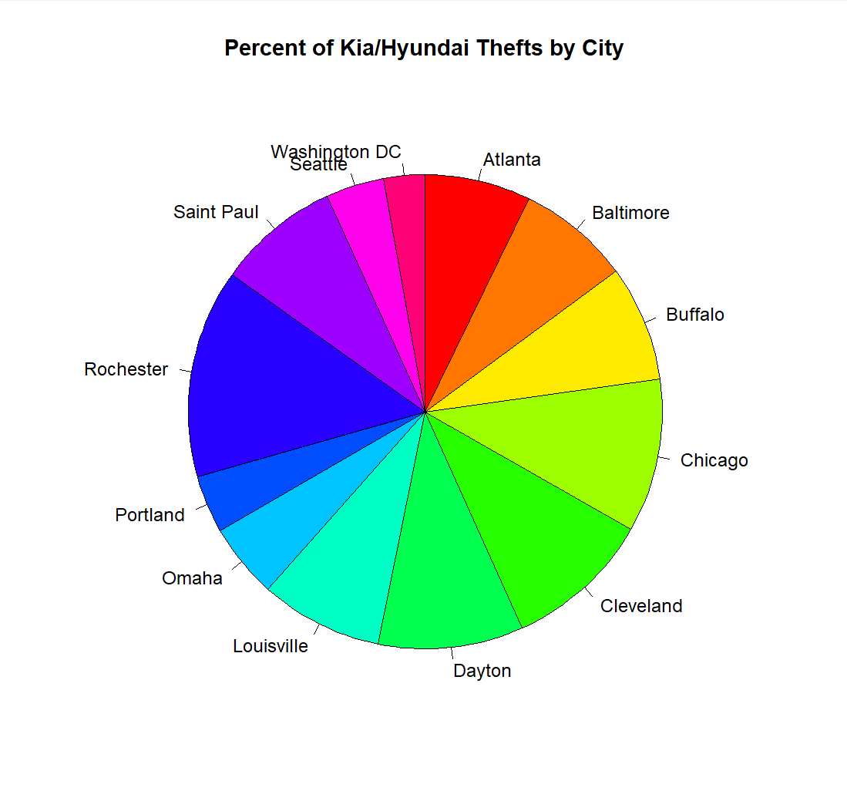
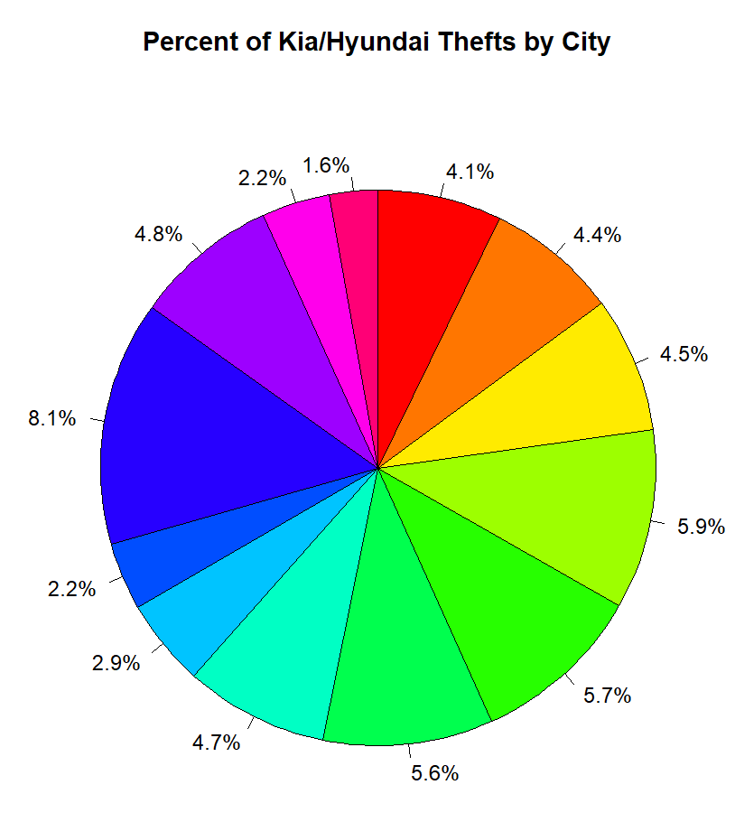
Percent of Kia/Hyundai Thefts by City Visualization Type: Pie Chart Data Source : kiaHyundaiThefts
Attached pie charts displaying the percentage of Kia/Hyundai thefts in different cities across USA.
The slices are colored using the rainbow palette and arranged clockwise. The chart is titled "Percent of Kia/Hyundai Thefts by City".

Slide 3
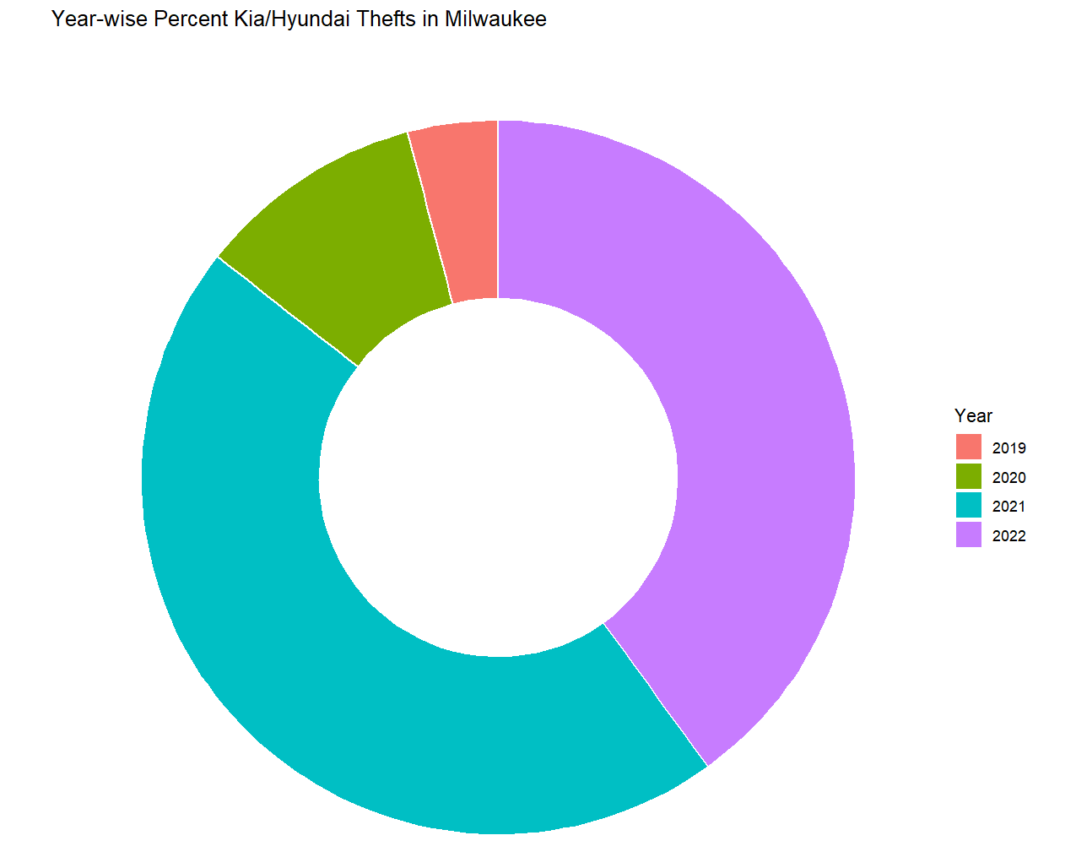
Year-wise Percent of Kia/Hyundai Thefts in MilWaukee Visualization Type: Donut Chart Data Source : KiaHyundaiMilwaukeeData
Attached visualization shows the year wise Kia/Hyundai Thefts in MilWaukee between year 2019-2022 based on the data received in KiaHyundaiMilwaukeeData.

Slide 4
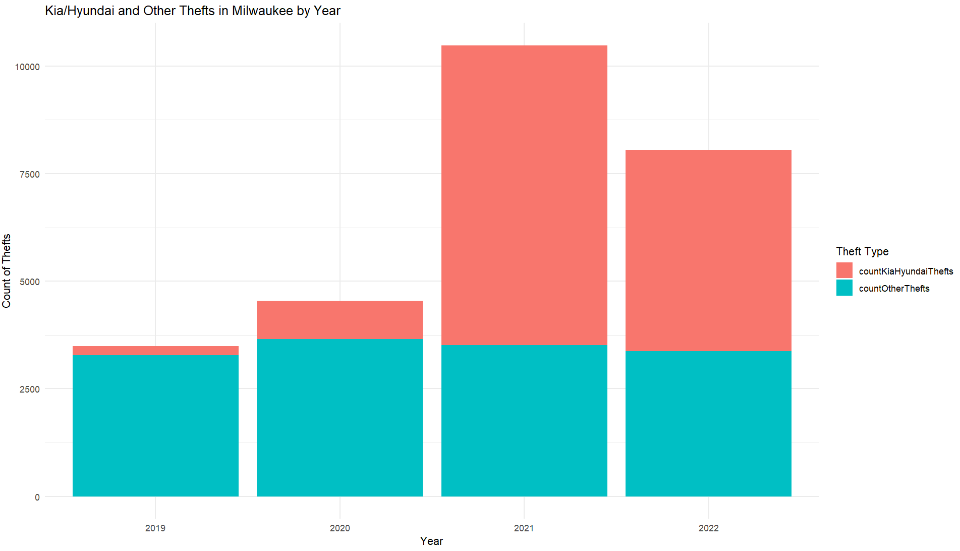
Kia/Hyundai and Other Thefts in MilWaukee by Year Visualization Type: Stachked bar chart Data Source : KiaHyundaiMilwaukeeData
Kia/Hyundai and other Thefts in MilWaukee by Year displayed in stacjked bar chart. 2021 and 2022 significantly shows the significant increase in kia/Hyundai car theft.

Slide 5
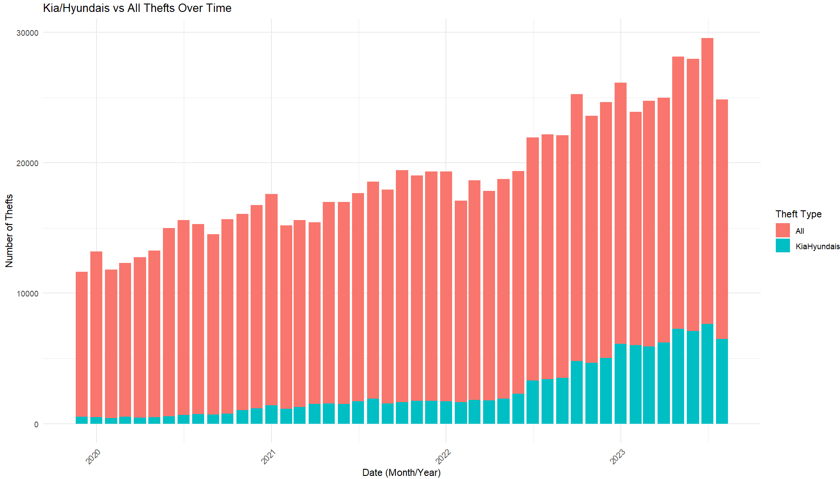
Kya/Hyundai Vs All Thefts over the Date Visualization Type: Stacked Bar Chart Data Source : Motherboard VICE News Kia Hyundai Theft Data
Attached stacked bar chart visualization shows the Kia/Hyundai vs all Thefts over the period. KiaHyundai Theft increased significantly since 2022 and in pick in 2023.

Slide 6
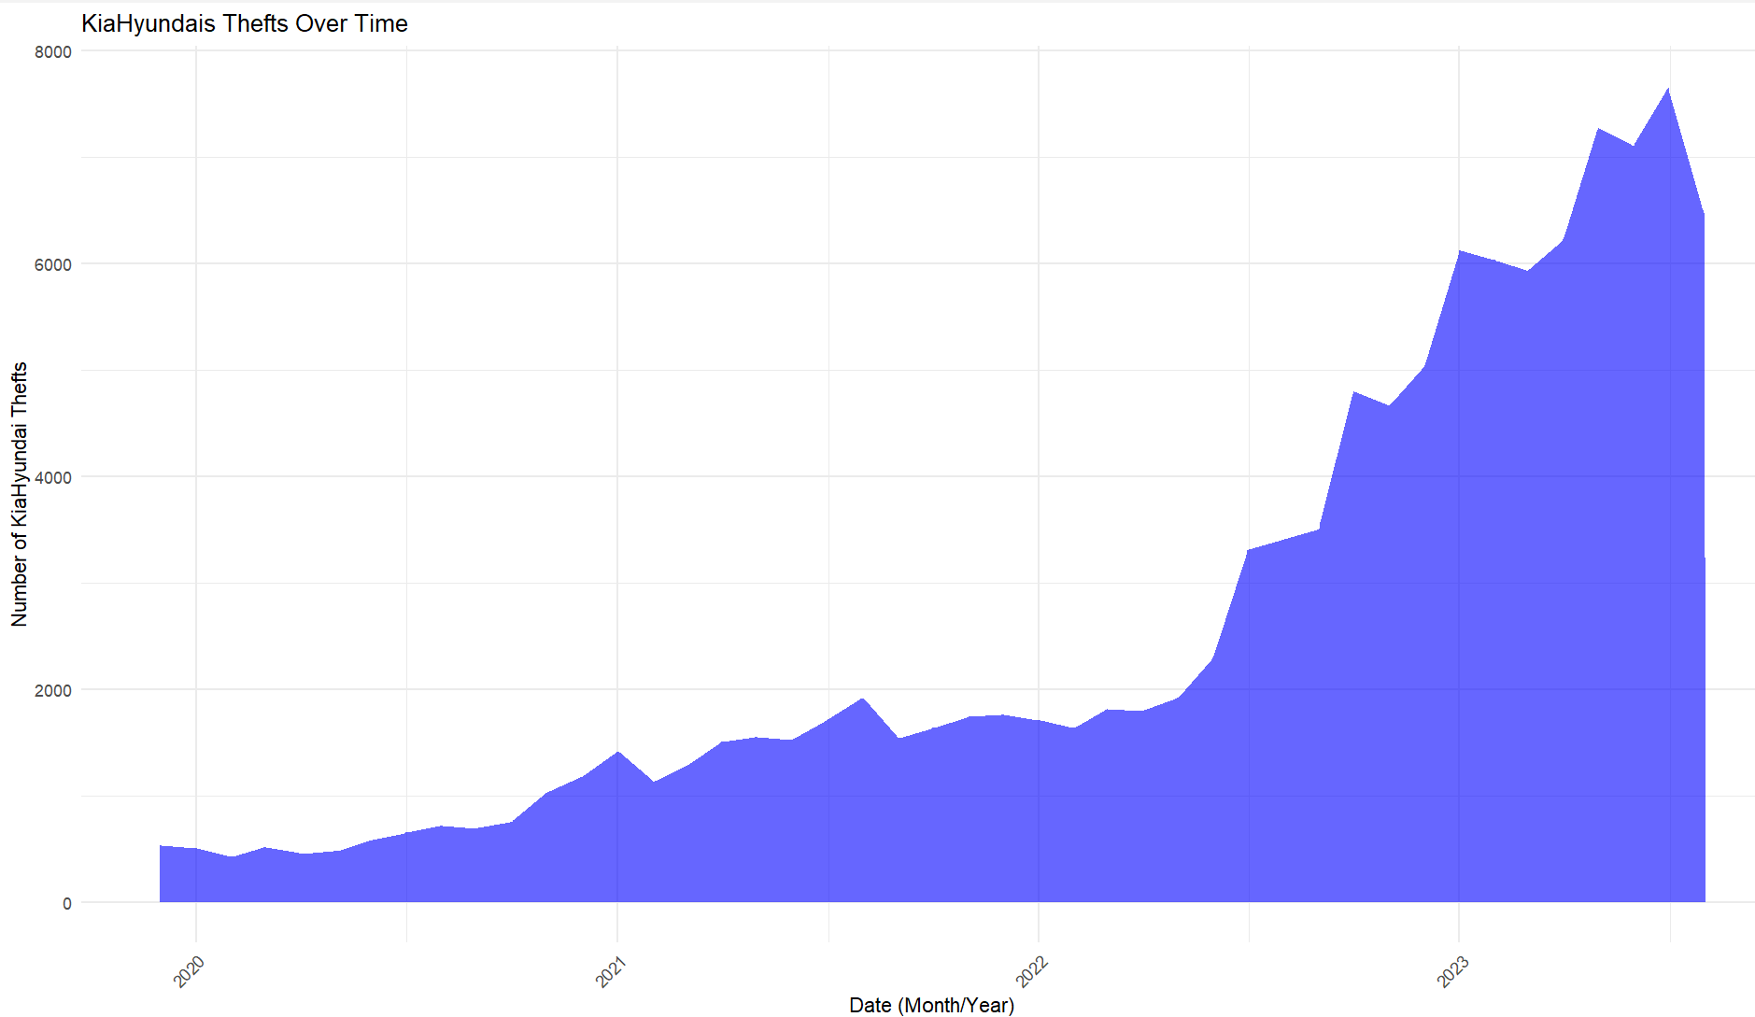
Kya/Hyundai Thefts over time Visualization Type: Area Chart Data Source: Motherboard VICE News Kia Hyundai Theft Data
The area chart visualizes the trend of Kia and Hyundai thefts over time, showing how the count of thefts has fluctuated across different months. The area is filled with a semi-transparent steel blue color to represent the number of thefts, allowing viewers to easily identify changes or patterns in the data over the observed period. This chart helps highlight periods of high or low theft activity.

Slide 7
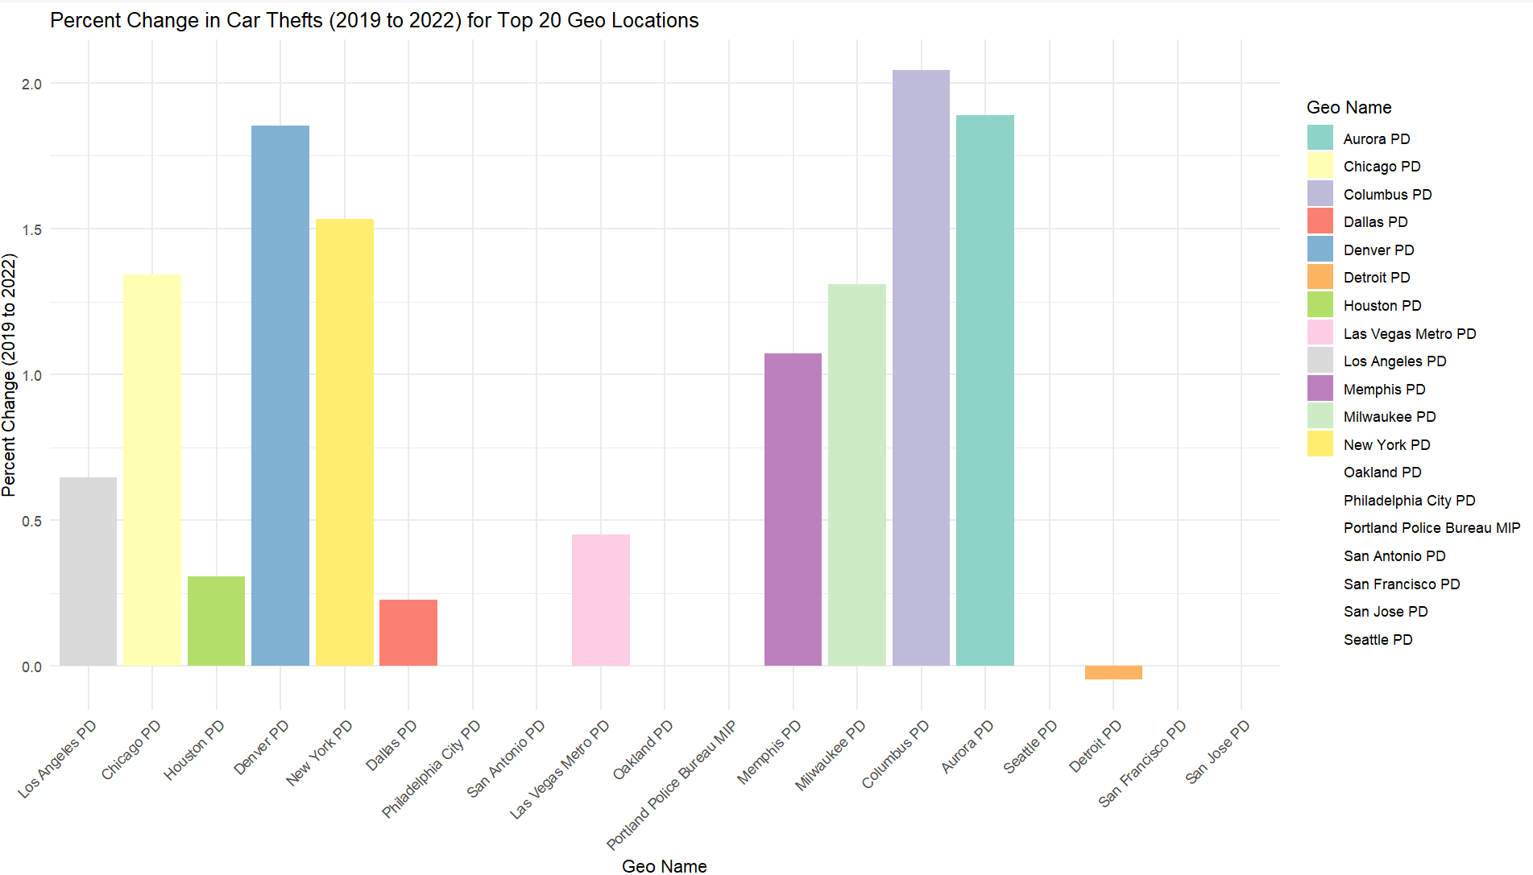
Percent change in car Thefts for Top 20 Geo location Visualization Type: Stacked Column Chart Data Source : carTheftsMap
The visualization is a stacked bar chart that shows the percentage change in car thefts from 2019 to 2022 for the top 20 geographic locations. The bars are ordered by the total number of car thefts in 2022, with each bar representing the percentage change over time. The color coding helps differentiate between the locations, and the x-axis labels are angled for clarity.

Slide 8
Thanks !!!

